Slide 1
MELBOURNE
HOUSING PRICES
Predicting Housing Prices in Melbourne, Australia
Presented by Usman Shaikh

Slide 2




Slide 3

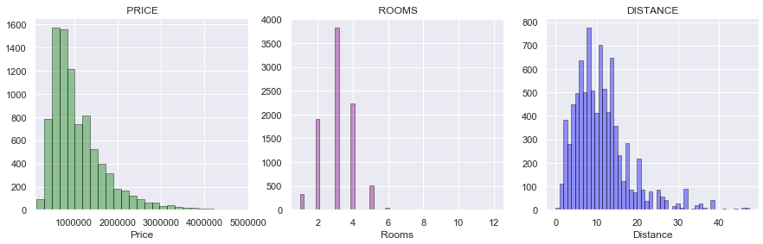
HISTOGRAMS

Slide 4
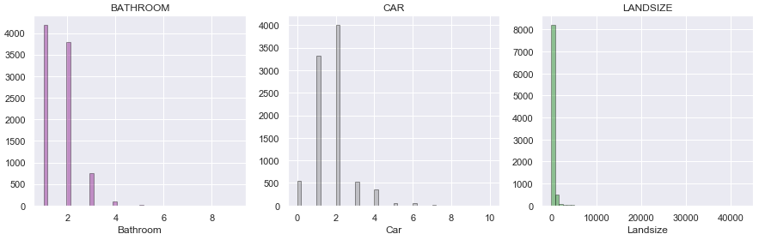
HISTOGRAMS

Slide 5
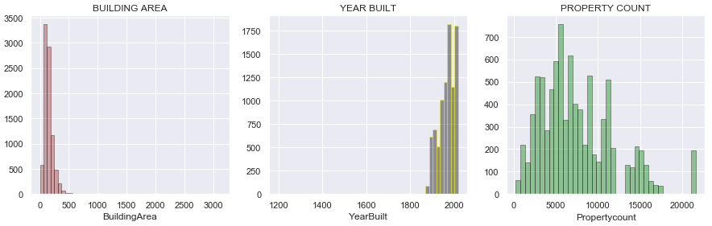
HISTOGRAMS

Slide 6
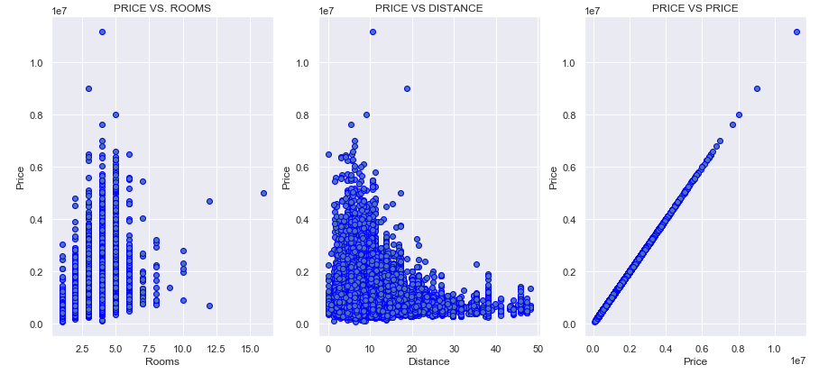
SCATTER PLOTS

Slide 7
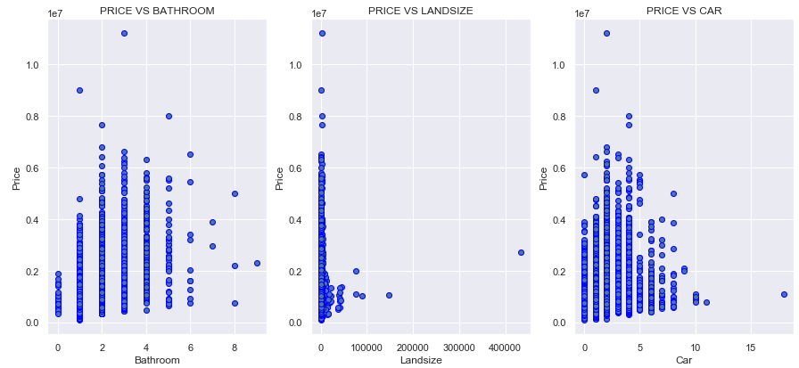
SCATTER PLOTS

Slide 8
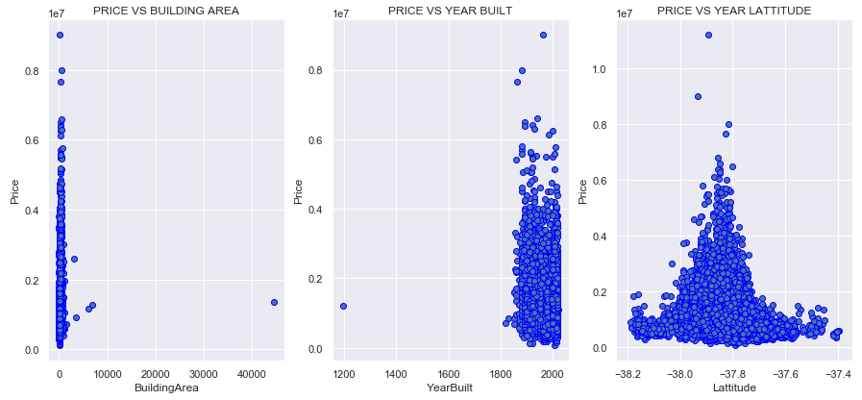
SCATTER PLOTS

Slide 9
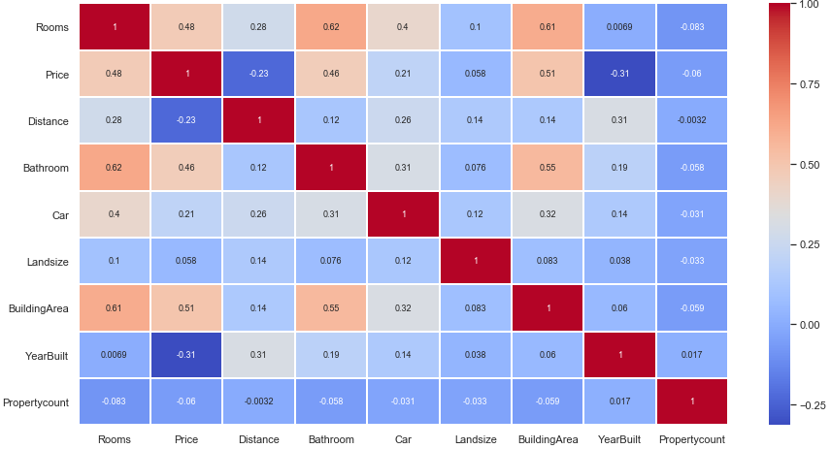
HEAT MAP

Slide 10
REGIONS
Northern Metropolitan: N Metro
Western Metropolitan: W Metro
Southern Metropolitan: S Metro
Eastern Metropolitan: E Metro
South-Eastern Metropolitan: SE Metro
Northern Victoria: N Vic
Eastern Victoria: E Vic
Western Victoria: W Vic

Slide 11
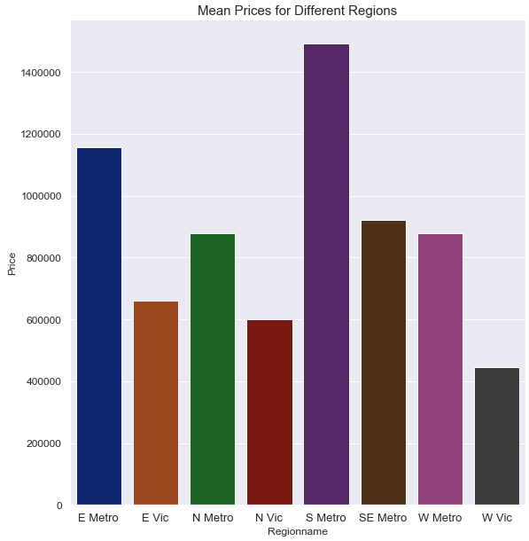
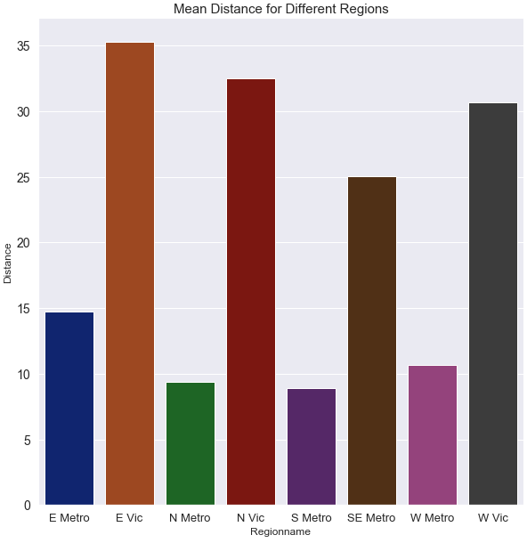
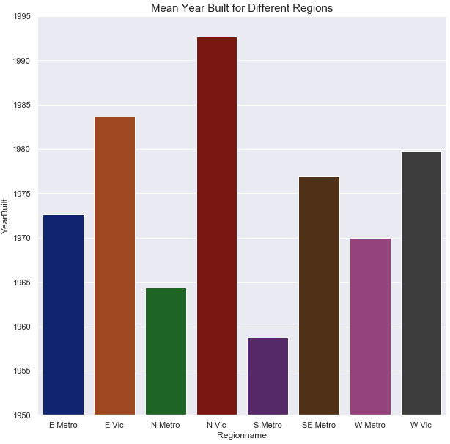
MEAN VALUES
Notes:
W Vic appears to be cheapest in price 3rd largest in distance, small land size, larger building area, more rooms, car spaces and less bathrooms.

Slide 12
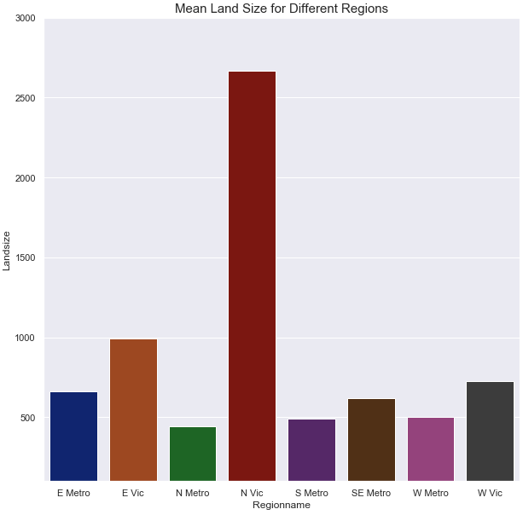
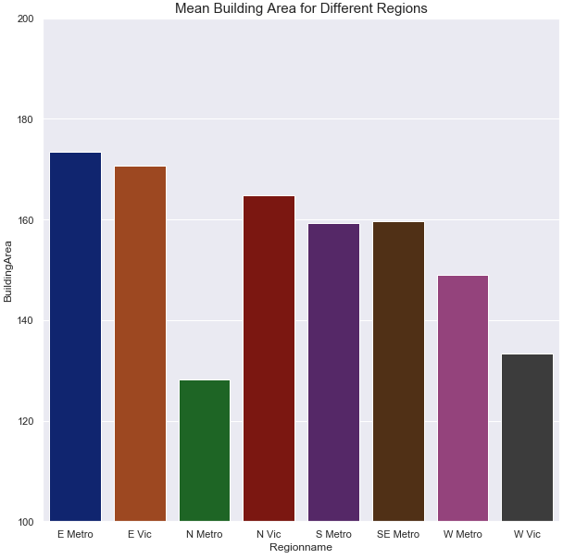
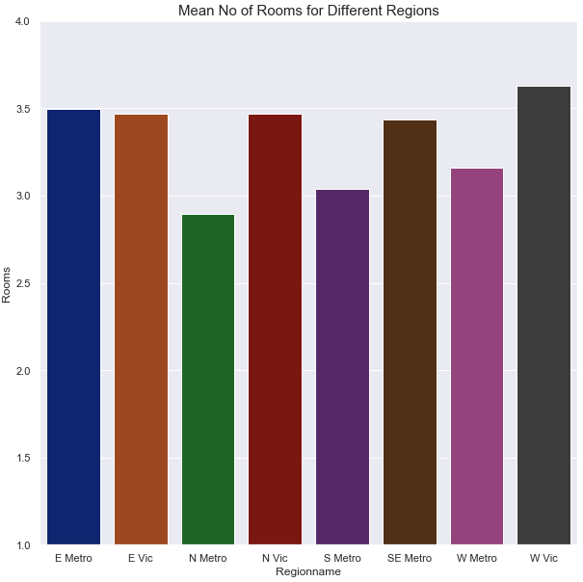
MEAN VALUES CONT’D

Slide 13
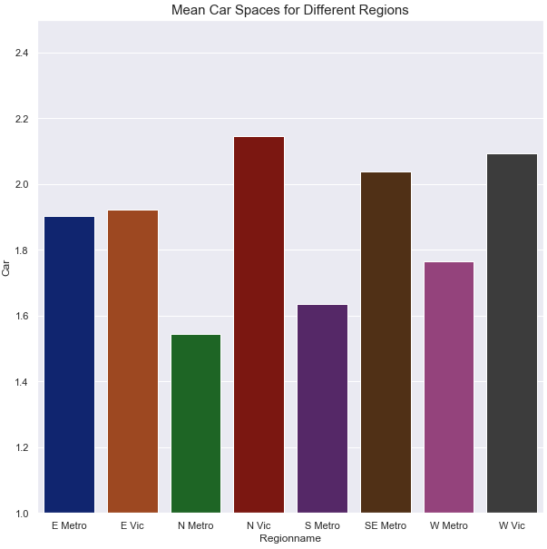
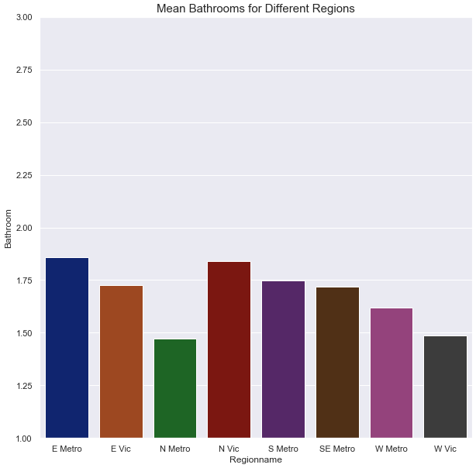
MEAN VALUES CONT’D

Slide 14
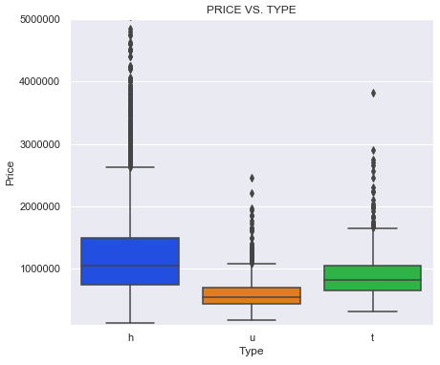
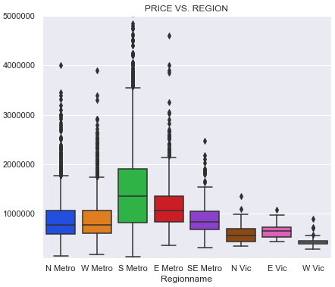
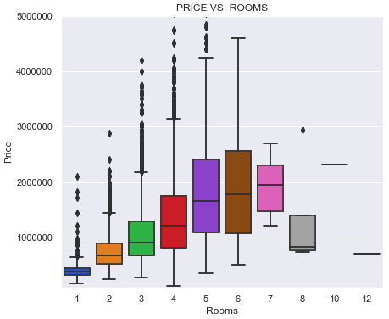
BOX PLOTS FOR PRICE

Slide 15
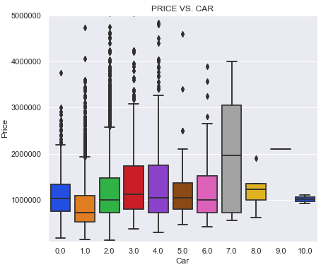
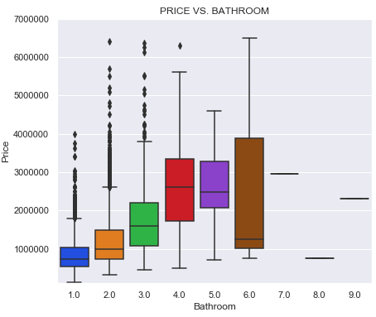
BOX PLOTS CONT’D

Slide 16
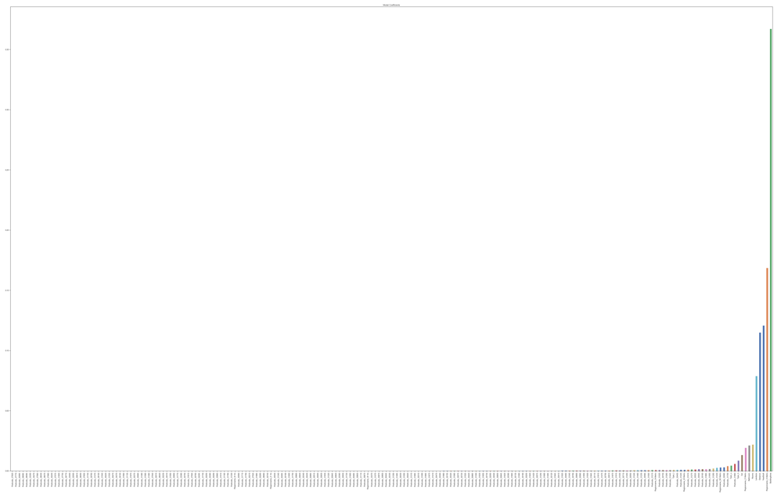
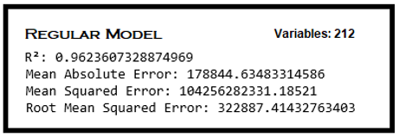
FEATURE SELECTION

Slide 17
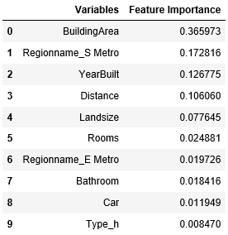
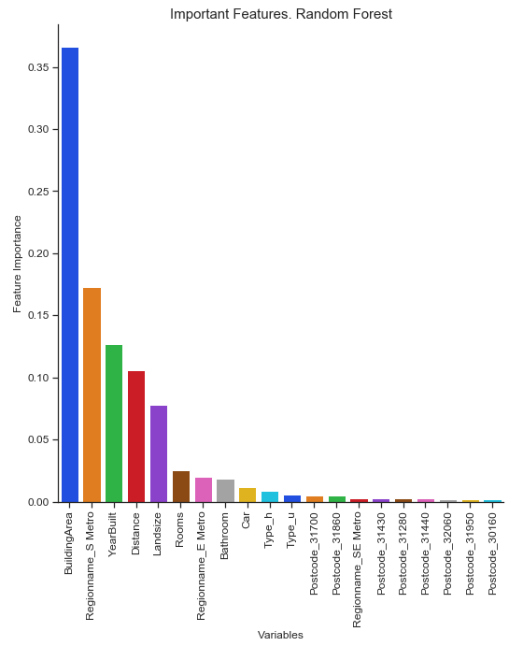
Top Ten Features for Random Forest

Slide 18
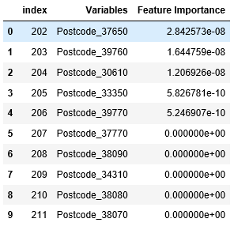
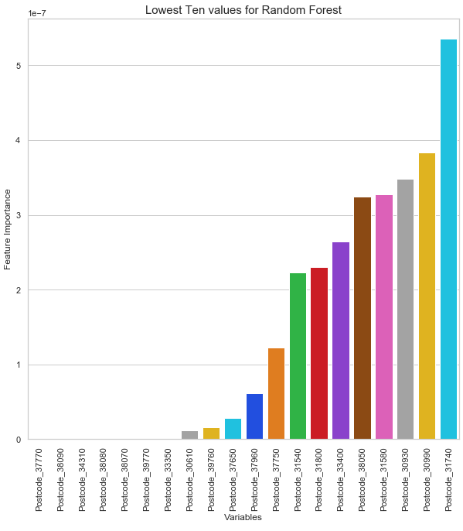
Lowest Ten Features for Random Forest

Slide 19
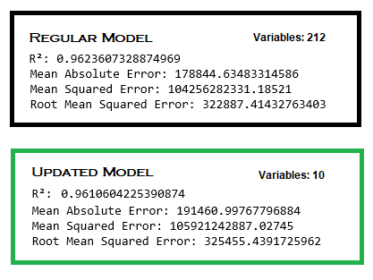
MODEL SCORES

Slide 20
FINDINGS
Most important factors impacting price of housing in Melbourne are ranked as follows.
Building Area
South Metro region
Year built
Distance
Landsize
Rooms
East Metro region
Bathroom
Car space
Home

Slide 21
FINDINGS CONT’D
E Vic, N Vic, W Vic appear to have cheaper price, large distance, large land size, more car space with 80’s and 90’s construction.
E Metro, N Metro, S Metro appears to have higher price, short distance, less land size, slightly less car space and 50’s, 60’s construction
SE Metro appears to be expensive at a distance with 2 car spaces and mid 70’s construction.
W Vic appears to be cheapest in price, 3rd largest in distance, small land size, larger building area, more rooms, car spaces and less bathrooms.
The supervised learning model appears to have high variance and low bias

